Slide 1

Ancientlink_Y
Presented by
hooi min Tan Grahn
2024-03-12

Slide 2

Basic concept
Most common ancestral haplogroup
Most ancient common ancestors
2 test users
Timeline
BCE (Before Common Era): the time before year 1
CE (Common Era): equivalent to the AD (Anno Domini) system, the time from year 1 onward
Haplotype: A group of alleles (DNA variants) at different closely linked chromosomal regions, that inherited together
Haplogroup: A group of similar haplotypes that share a common ancestor based on shared genetic variants
Y-chromosome haplogroup: Haplogroups associated with paternal lineages in human genetics
Tools integrate ancient DNA data with modern haplogroup information: pathPhynder, AncientDNA.info, Allen Ancient DNA Resource (AADR), aYChr-DB (Eran Elhaik)
ANCIENTLINK_Y Information
Input data: International Society of Genetic Genealogy (ISOGG), Allen Ancient DNA Resource (AADR)
Administrator: bash line (Terminal) connects to the website, user’s output kept at the admin’s app directory
In conda environment, Python packages: streamlit, pandas, network, pyvis.network, numpy, time

Slide 3
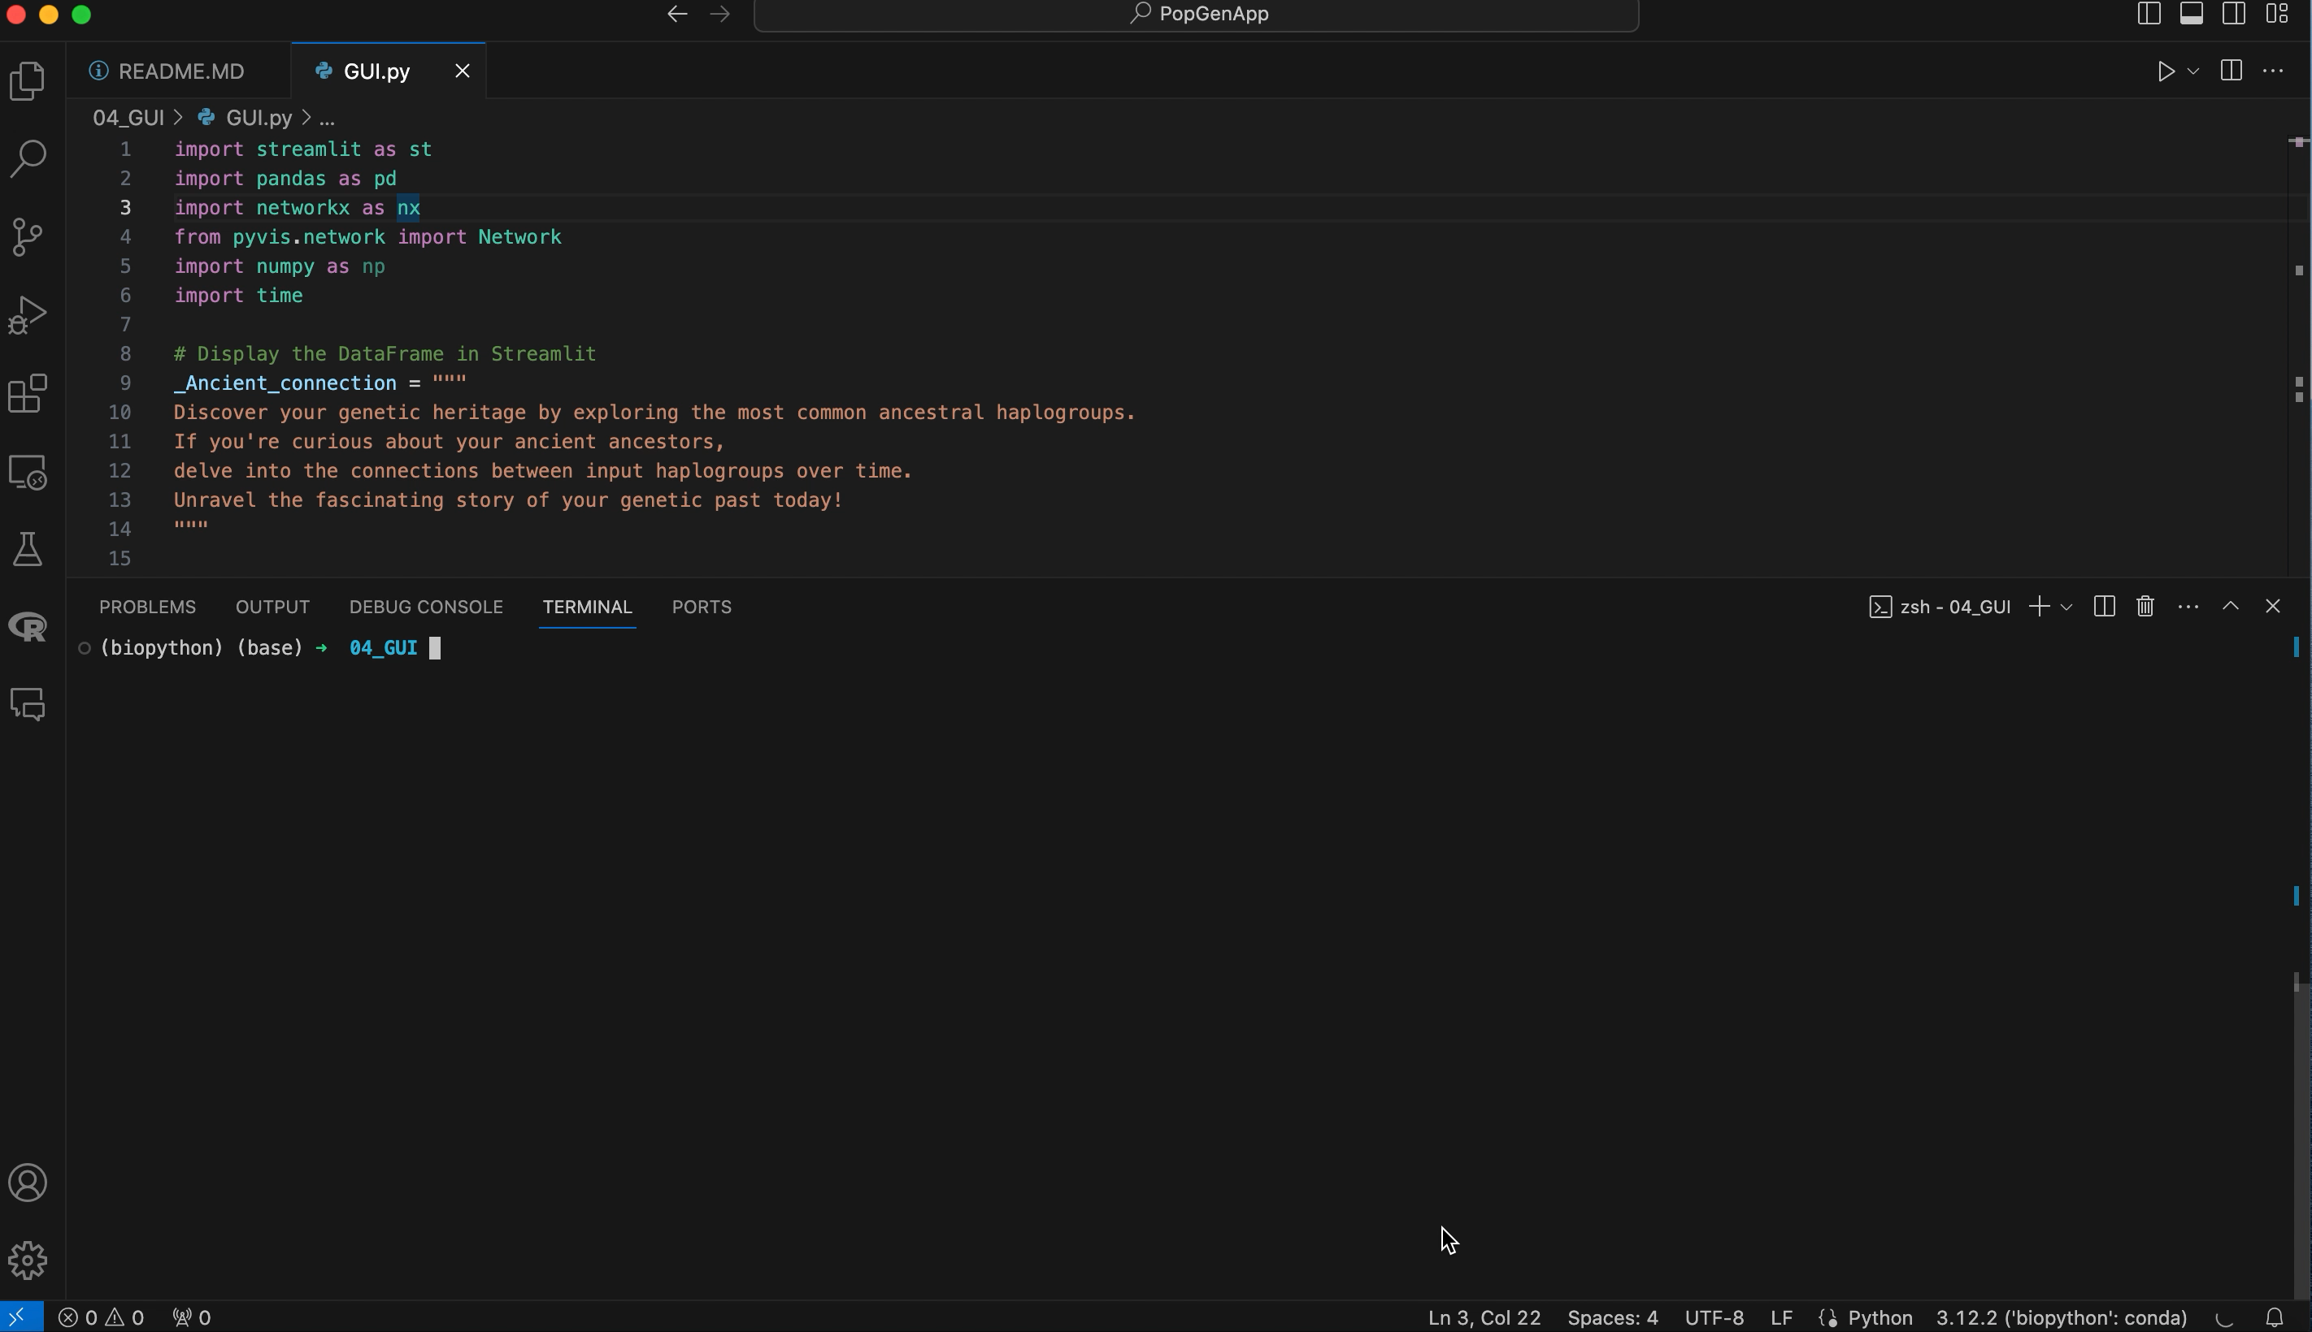
Addressing a Research niche
Visually explore complex genetic networks, identify patterns, and interpret
relationships between haplogroups
User friendly interface

Slide 4
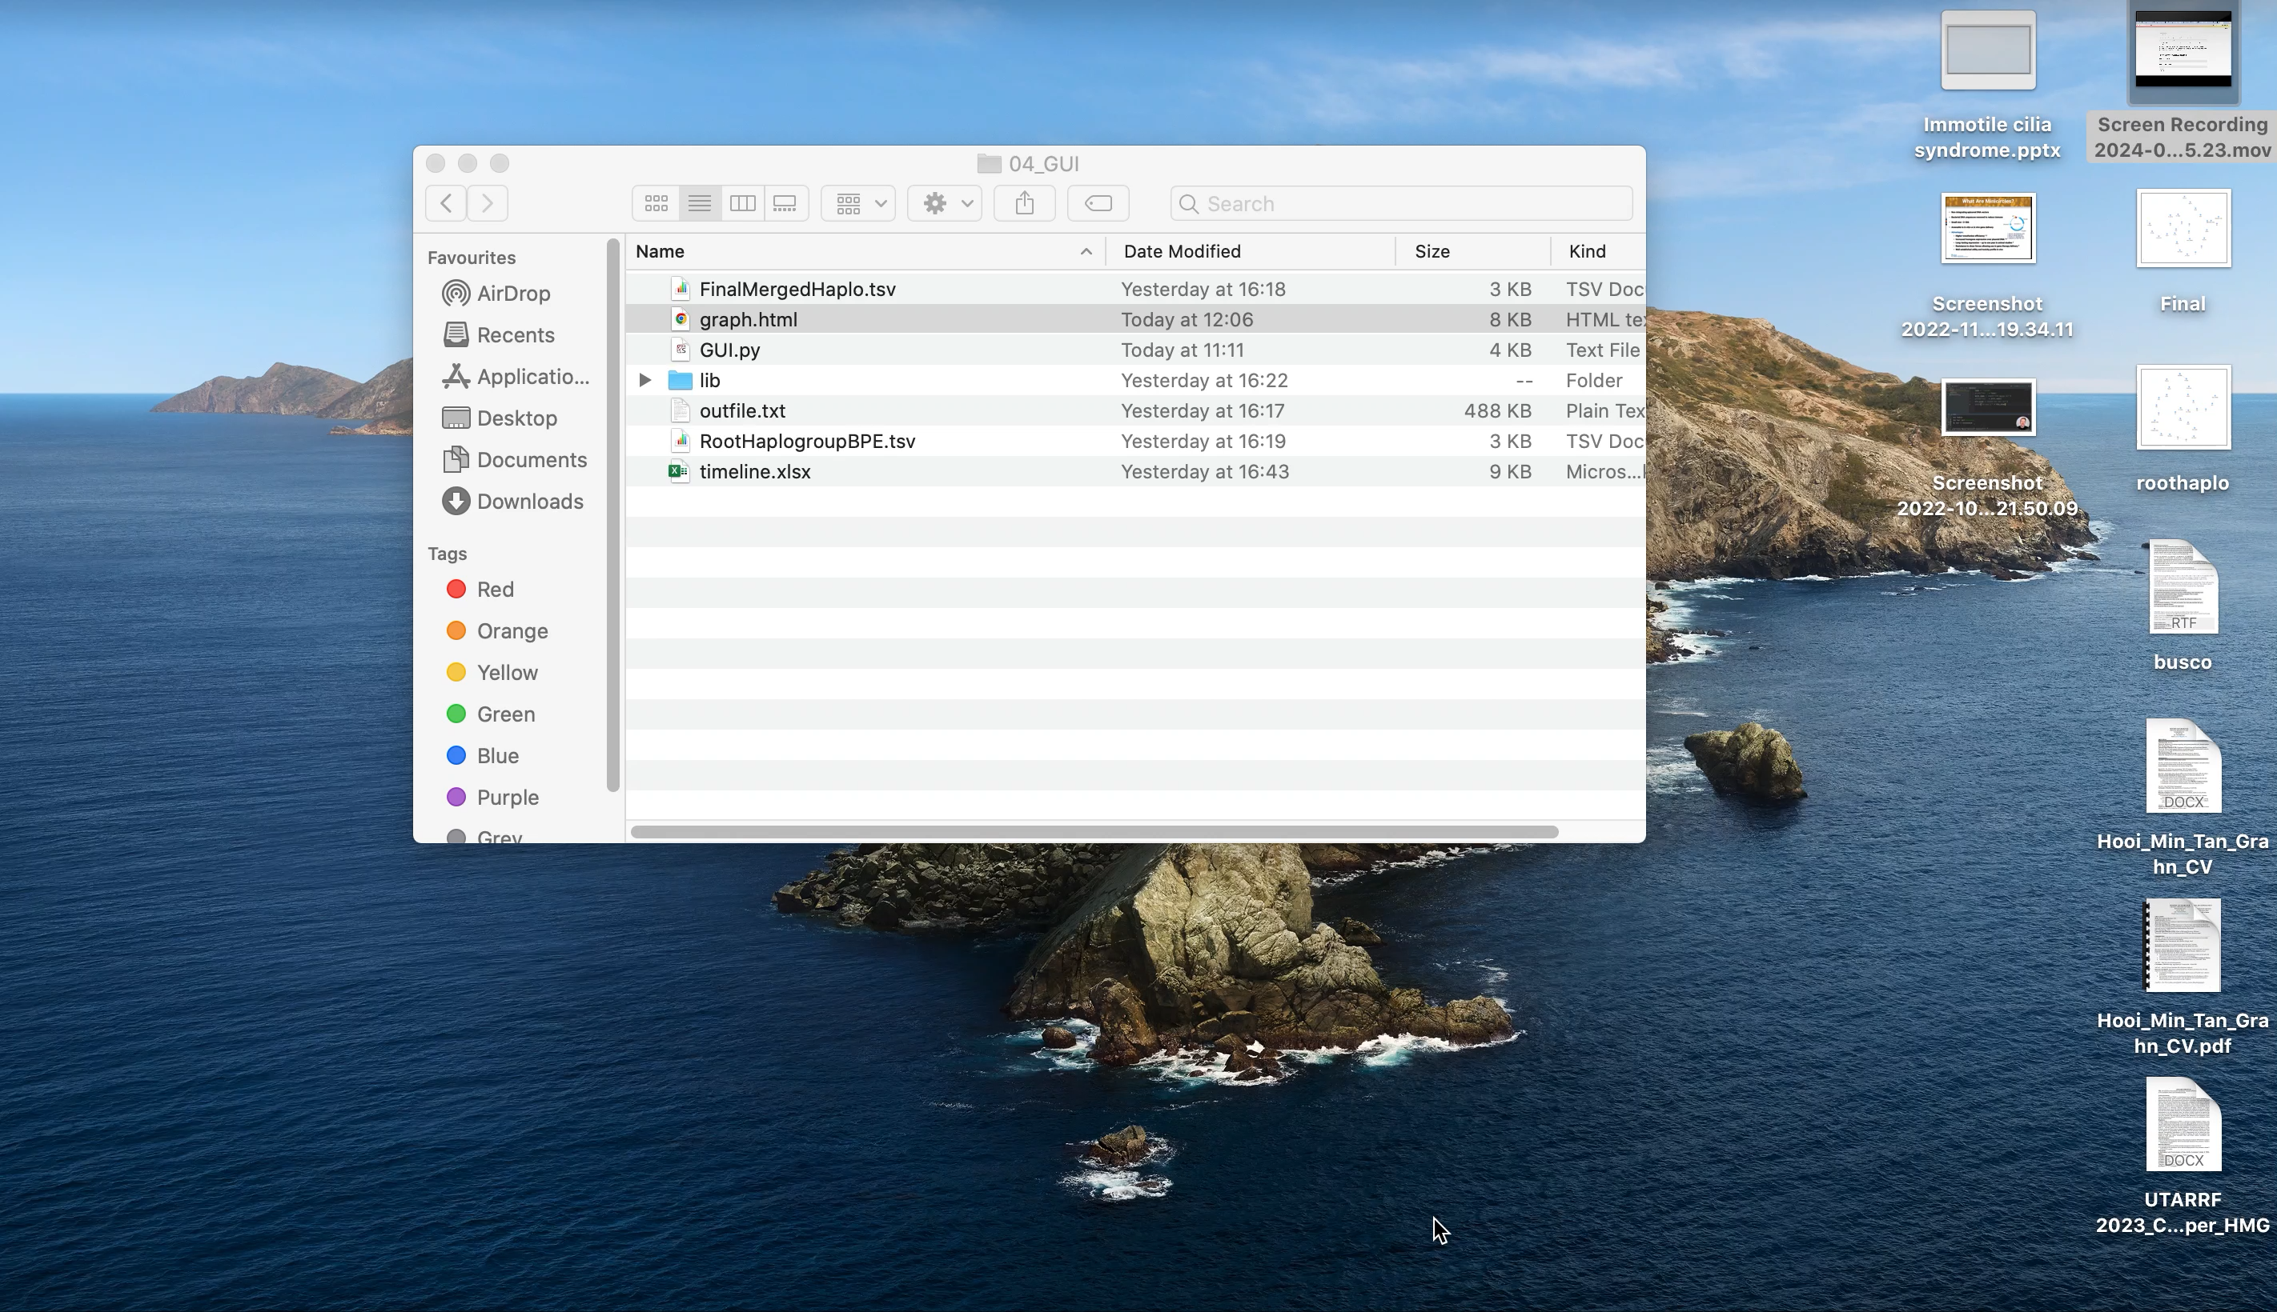
Features
Highlight features: configurable layouts, node dragging, and edge coloring that
facilitate data exploration and hypothesis generation

Slide 5
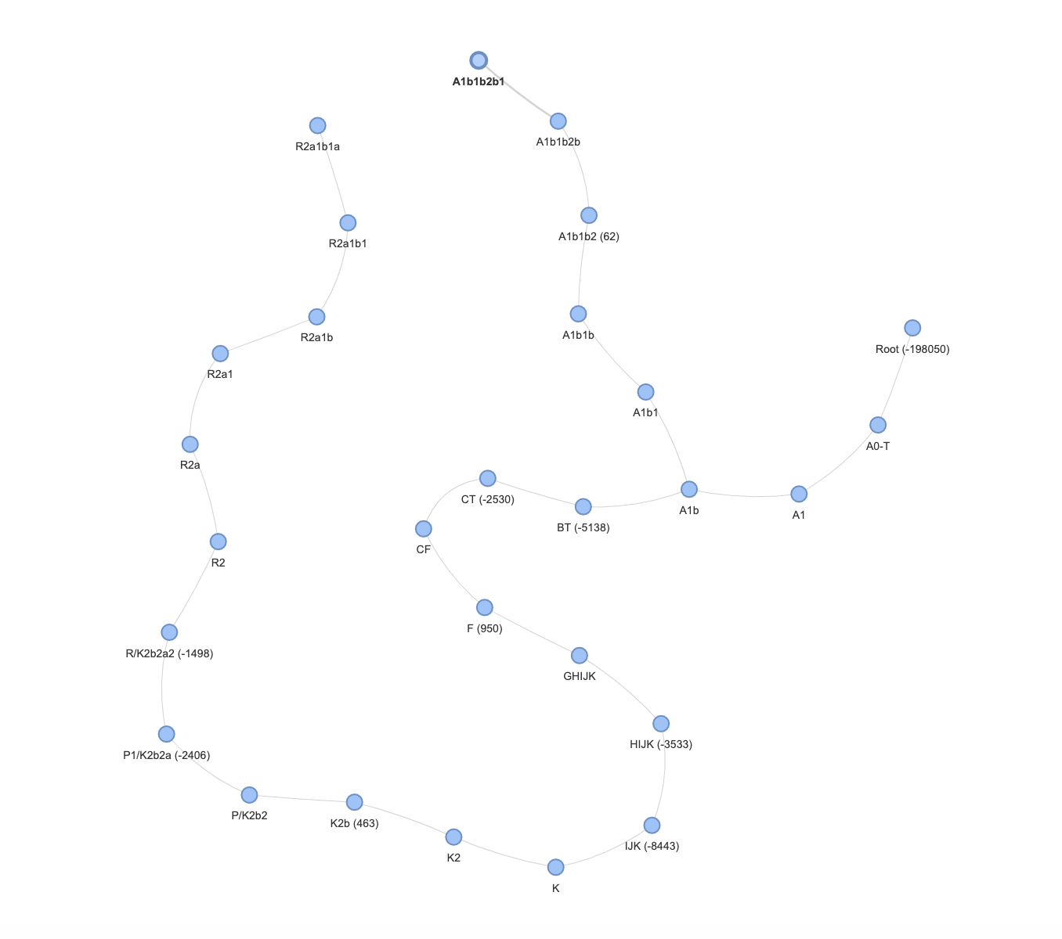
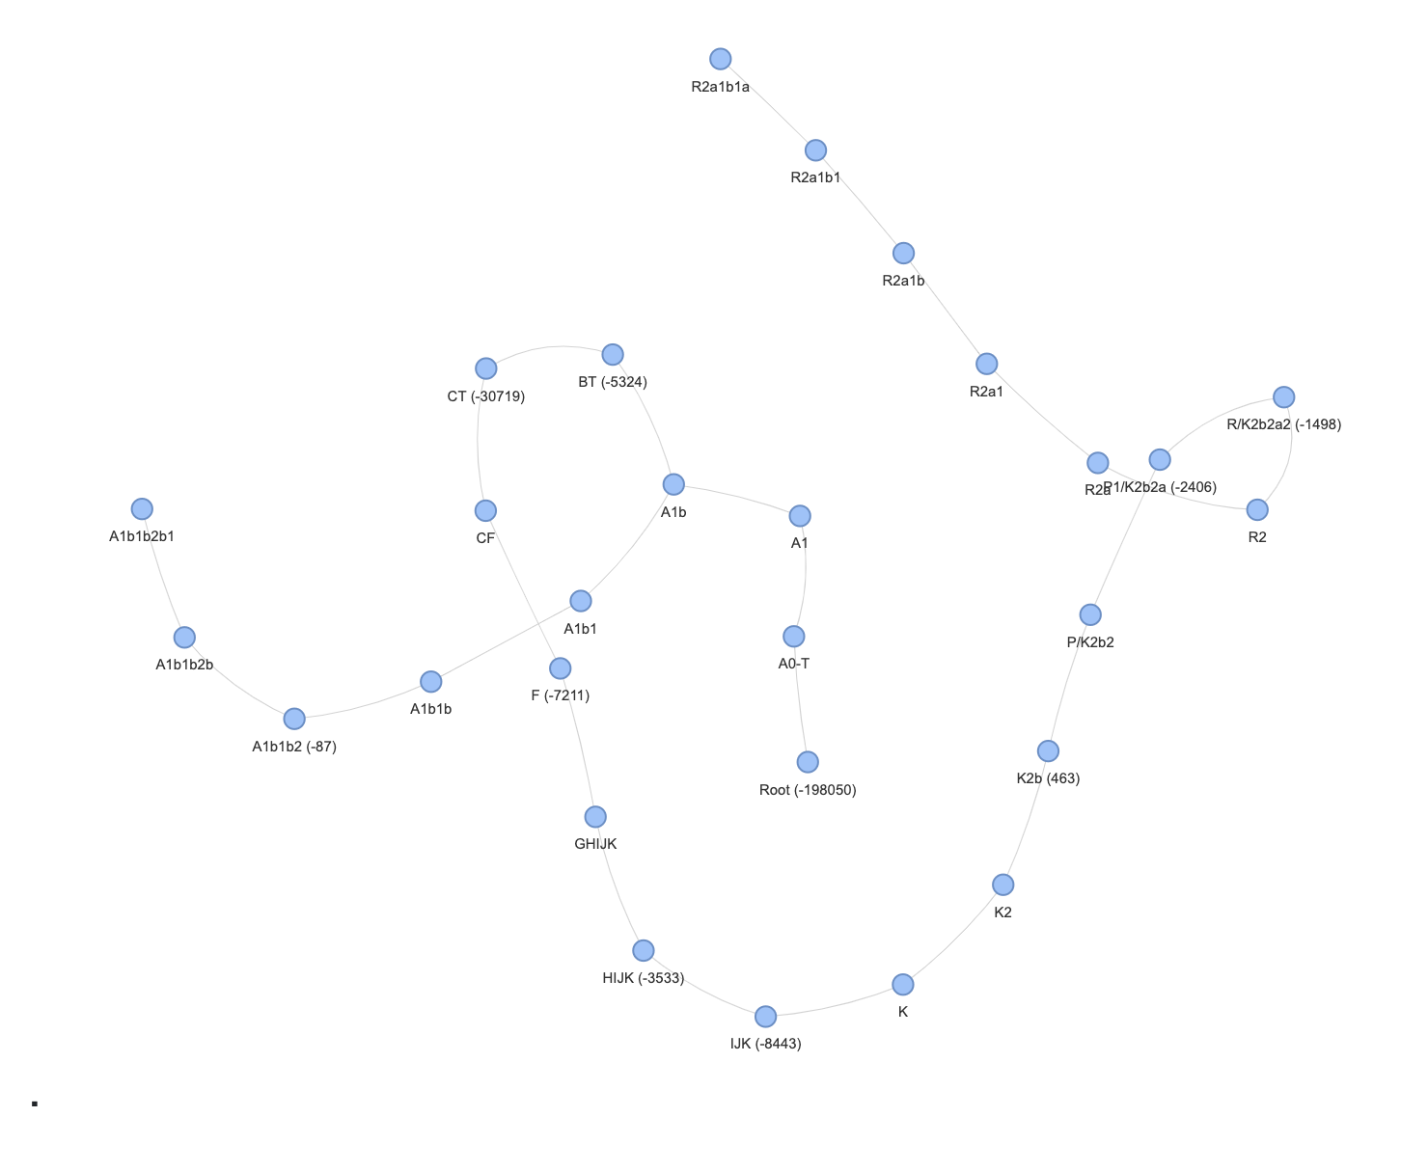
limitation
Similar haplogroup appears at two different age period

Slide 6
Conclusion
Future plans
Incooperate flexible features for inputing datasets
Improving data preprocessing tool
Most common ancestral haplogroup
Most ancient common ancestors
2 test users
A1b1b2b1
R2a1b1a
A1b
A0-T
Timeline

Slide 7
Pipeline used in python, files filtering
PopGenApp
01_PopGenApp
02_Plot
03_CheckCE
04_GUI

Slide 8
Pipeline used in python, Streamlit (GUI)
Bash line (terminal)
Input:
Haplogroup User 1
Haplogroup User 2
Define the stream data function
Can the haplogroup name
be found in the RootHaplogroupBPE.tsv or FinalMergedHaplo.tsv
(Subset of AADR.tsv)
Add haplogroup as
node to graph
Yes
No
Read outfile.txt
(lineage haplogroup of ISOGG
Y-chromosom)
Return error
Add edge to graph
based on outfile.txt
Checking user input and
creating a subgraph
Visualizing the graph

